Slide 1
Progress Report
Keerat Singh
Notes:
Add graphics

Slide 3
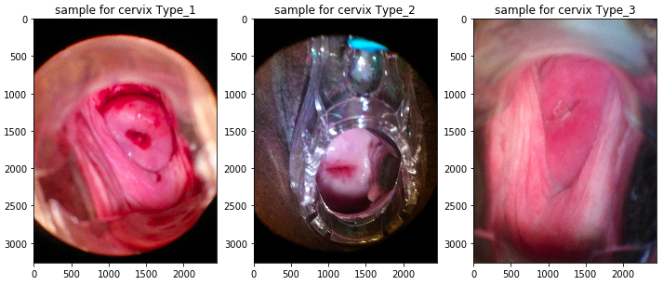

Slide 4
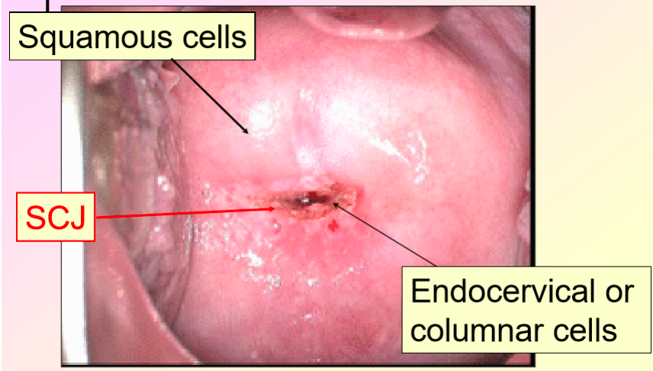
Data

Slide 5
Projected Plan
Download data
Clean and analyze data
Histogram
equalizations
Probablistic neural network
Self Organizing Map
PCA
Notes:
Add graphics Then elaborate more on each thing

Slide 6
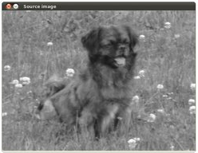
Histogram equalizations

Slide 7
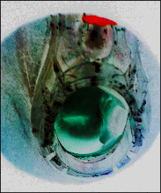
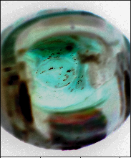
Usable
Not Usable
25/30 were “useable”

Slide 8
Principal component analysis (PCA)
Entered into PCA
Returned by PCA

Slide 9
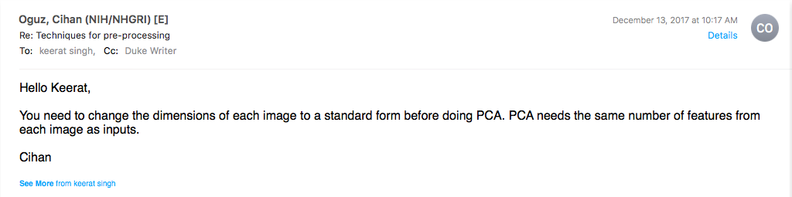

Slide 10
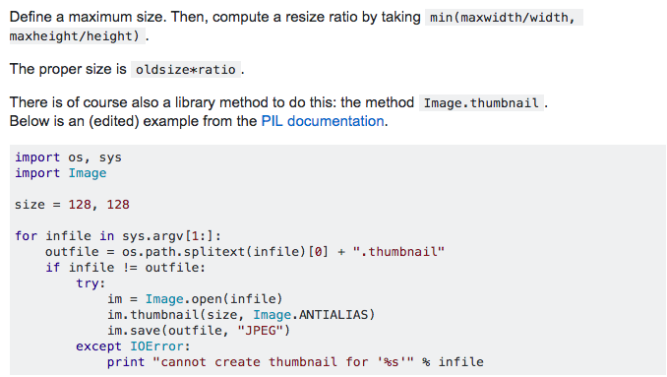
Attempt #1

Slide 11
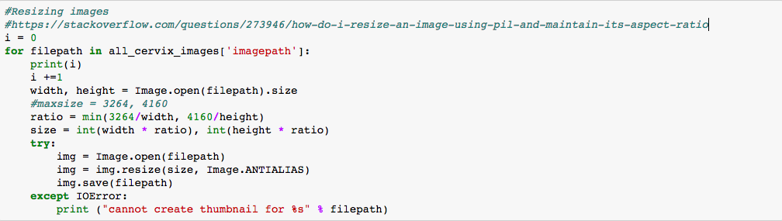
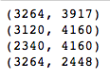
Attempt #1

Slide 12
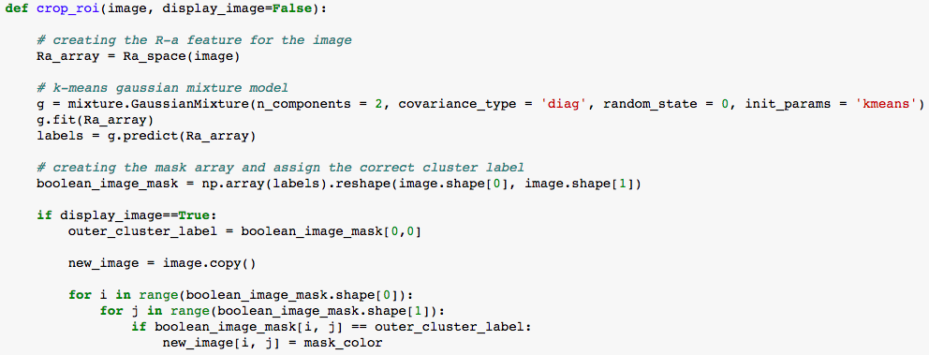
Attempt #2

Slide 13
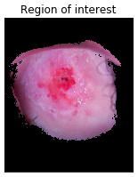
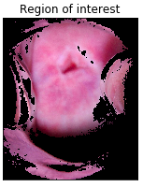
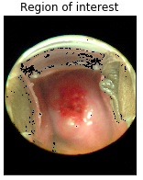
Attempt #2

Slide 14
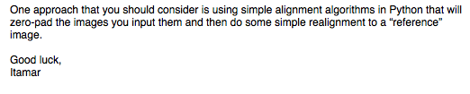
Future Work

Slide 15
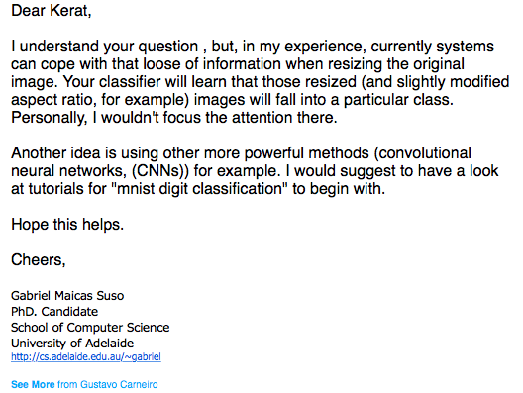
Future Work

Slide 16
Next steps
Start PCA
Implement self-organizing maps and probabilistic neural network using OpenCV
Look into Convolutional Neural Netwroks

Slide 17
References
Chen, E., Chung, P., Chen, C., Tsai, H., & Chang, C. (1998). An automatic diagnostic system for CT liver image classification. IEEE Transactions on Biomedical Engineering, 45(6), 783-794. doi:10.1109/10.678613
Lawrence, S., Giles, C., Tsoi, A. C., & Back, A. (1997). Face recognition: a convolutional neural-network approach. IEEE Transactions on Neural Networks, 8(1), 98-113. doi:10.1109/72.554195
Saeed, K., & Werdoni, M. (2014). A New Approach for Hand-Palm Recognition. Enhanced Methods in Computer Security, Biometric and Artificial Intelligence Systems, 185-194. doi:10.1007/0-387-23484-5_18

